Slide 1
CS-211 Data Structure & Algorithms
Lecture # 3
Sets and Maps

Slide 2
Sets - Introduction
The Set ADT is a common container used in computer science.
A set stores unique values and represents the same structure found in mathematics.
Store a collection of unique values.
Performs various mathematical set operations on collections.

Slide 3
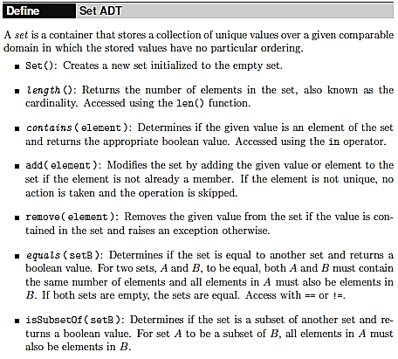
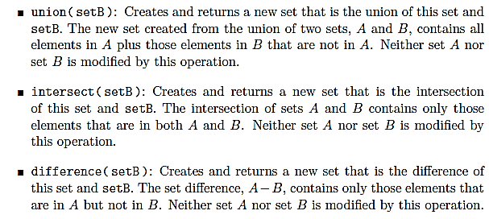

Sets - ADT

Slide 4
Sets - Example
smith = Set() smith.add( "CSCI-112" ) smith.add( "MATH-121" ) smith.add( "HIST-340" ) smith.add( "ECON-101" ) roberts = Set() roberts.add( "POL-101" ) roberts.add( "ANTH-230" ) roberts.add( "CSCI-112" ) roberts.add( "ECON-101" )
if smith == roberts : print( "Smith and Roberts are taking the same courses." ) else : sameCourses = smith.intersection(roberts ) if len(sameCourses)==0 : print( "Smith and Roberts are not taking any of the same courses." ) else : print( "Smith and Roberts are taking some of the same courses:" ) for course in sameCourses : print( course ) print('Smith is taking courses different from Roberts.') uniqueCourses = smith.difference( roberts ) for course in uniqueCourses : print( course )

Slide 5
Sets - Example
--------------------------------------------------
Smith is taking courses:
CSCI-112, MATH-121, HIST-340, ECON-101,
--------------------------------------------------
Smith is taking courses:
POL-101, ANTH-230, CSCI-112, ECON-101,
--------------------------------------------------
Smith and Roberts are taking some of the same courses:
CSCI-112
ECON-101
--------------------------------------------------
Smith is taking courses different from Roberts.
MATH-121
HIST-340

Slide 6
Sets - Selecting a Data Structure
Bag?
bag and set are very similar with the difference being that a set cannot contain duplicates.
Dictionary?
stores key/value pairs, which requires two data fields per entry – waste of space
Array?
a set can contain any number of elements and by definition an array has a fixed size.
List?
list can grow as needed; it can provide for the complete functionality of the ADT.

Slide 7
Sets - List-Based Implementation

Slide 8
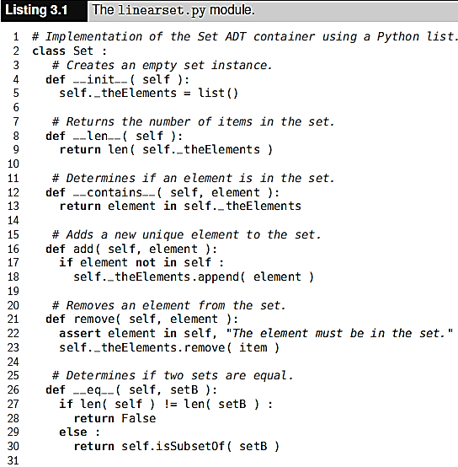
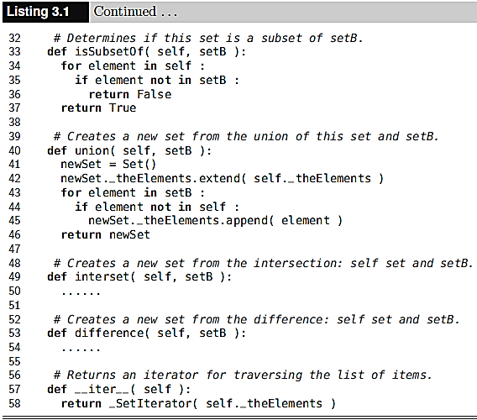
Sets - List-Based Implementation

Slide 9
Maps
Searching for data items based on unique key values is often referred to Maps or Dictionary.
It maps a key to a corresponding value.
Key | Value
10210 | Brown Jessica
10175 | Smith John
10142 | Roberts Susan
10016 | Smith Jane

Slide 10
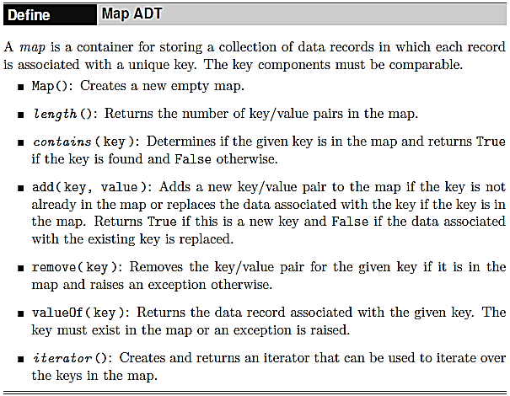
Maps - ADT

Slide 11
Maps - List-Based Implementation
Bag?
Duplicate items
Array?
Fixed length
List?
Two lists?
each key/value must be stored in corresponding elements of the parallel lists and that association must be maintained.
Single list?
The individual keys and corresponding values can both be saved in a single object, with that object then stored in the list.

Slide 12
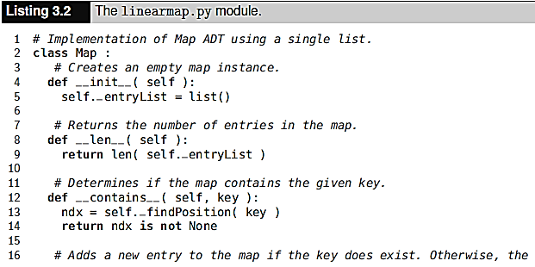
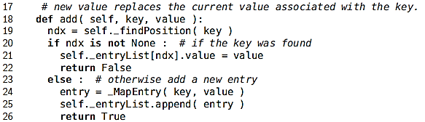
Maps - List-Based Implementation

Slide 13
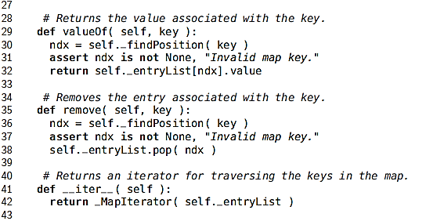
Maps - List-Based Implementation

Slide 14
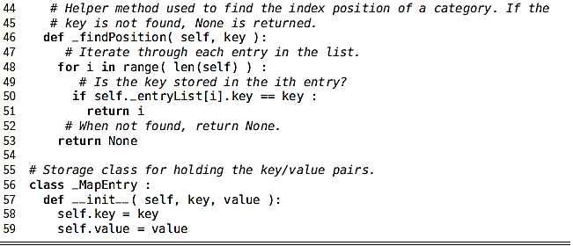
Maps - List-Based Implementation

Slide 15
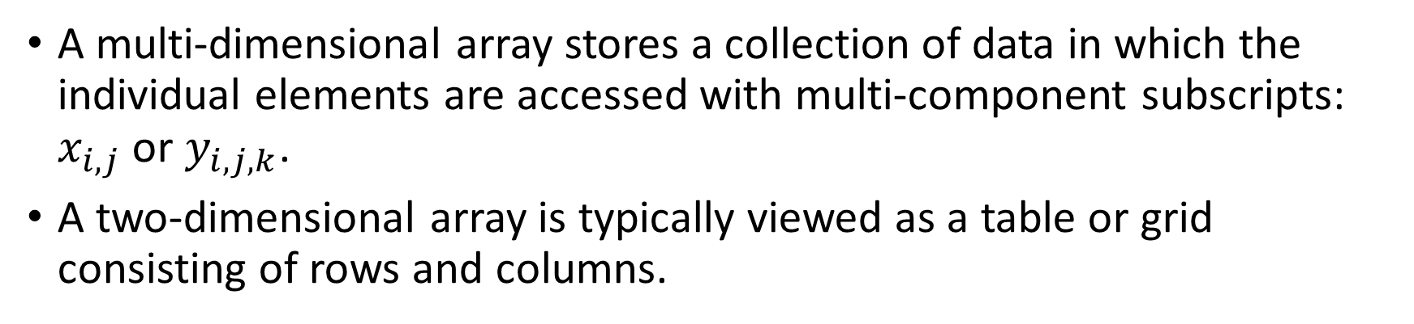
Multi-Dimensional Arrays
A multi-dimensional array stores a collection of data in which the individual elements are accessed with multi-component subscripts: $x_{i,j}$ or $y_{i,j,k}$.
A two-dimensional array is typically viewed as a table or grid consisting of rows and columns.

Slide 16
Multi-Dimensional Arrays
The three-dimensional array can be visualized as a box of tables where each table is divided into rows and columns.
Larger dimensions are used in the solutions for some problems, but they are more difficult to visualize.

Slide 17
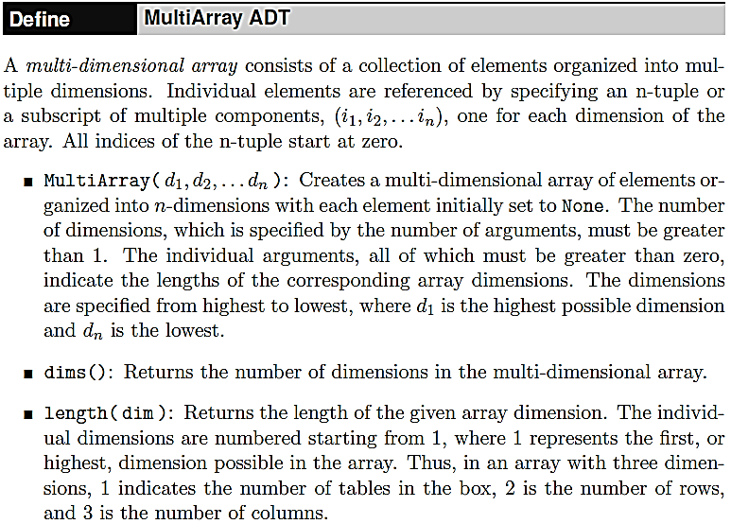
The Multi-Array ADT

Slide 18
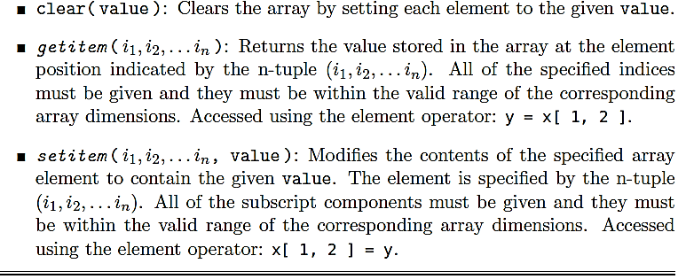
The Multi-Array ADT

Slide 19
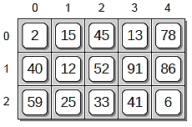
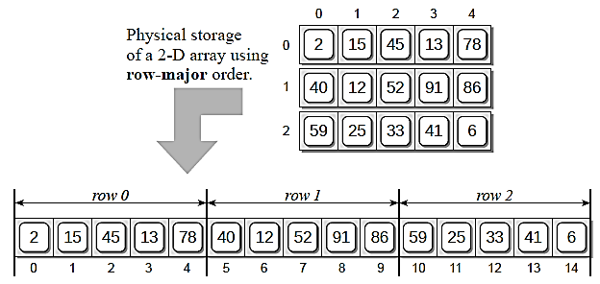
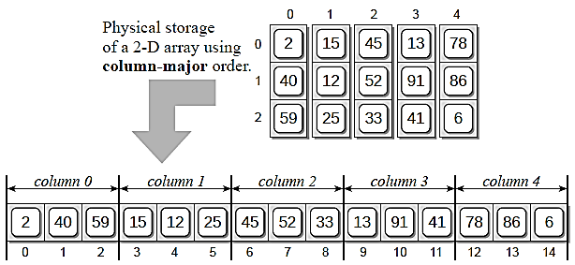
Data Organization - Array Storage
✓
row-major order
column-major order.

Slide 20
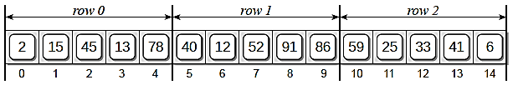
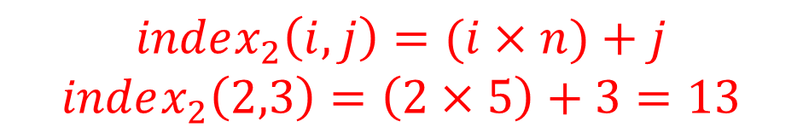
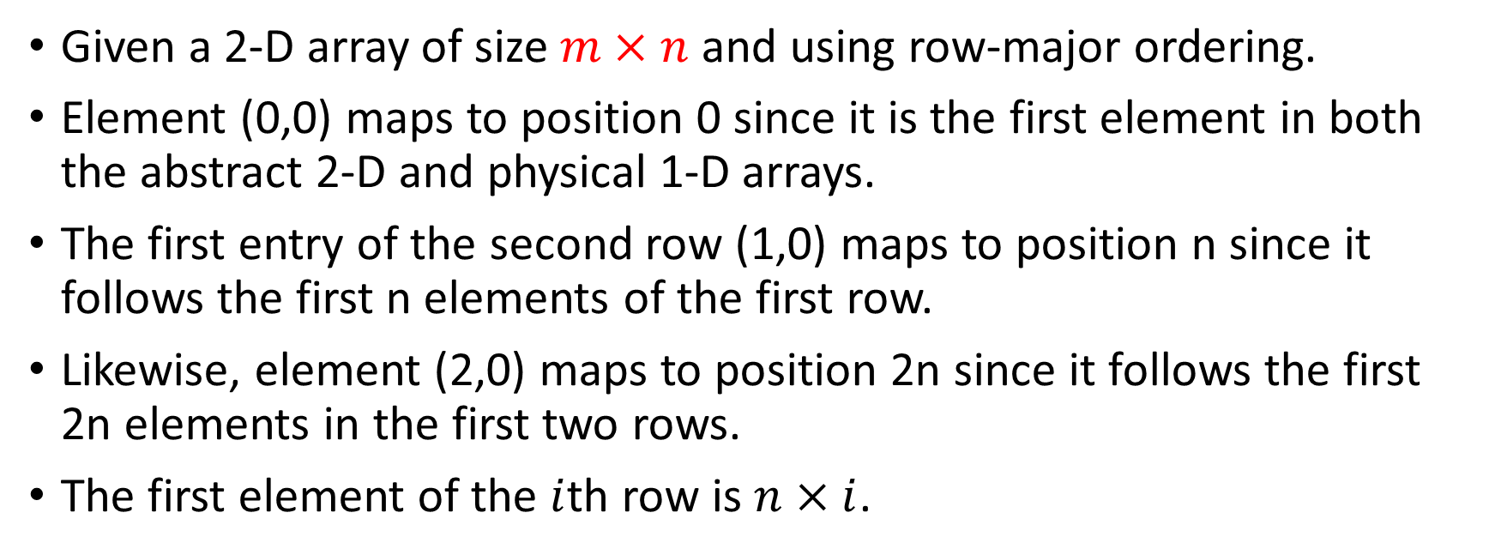
Data Organization – Index Computation 2D
Given a 2-D array of size $m×n$ and using row-major ordering.
Element (0,0) maps to position 0 since it is the first element in both the abstract 2-D and physical 1-D arrays.
The first entry of the second row (1,0) maps to position n since it follows the first n elements of the first row.
Likewise, element (2,0) maps to position 2n since it follows the first 2n elements in the first two rows.
The first element of the $i$th row is $n×i$.
$$index_{2}\left(i,j\right)=(i×n)+j$$
$$index_{2}\left(2,3\right)=\left(2×5\right)+3=13$$

Slide 21

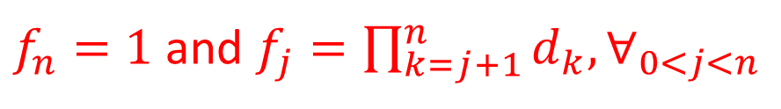
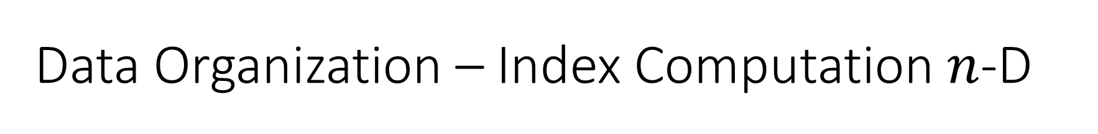
Data Organization – Index Computation $n$-D
A 3-D array of size $d_{1}×d_{2}×d_{3}$, the 1-D array offset of element $\left(i_{1},i_{2},i_{3}\right)$ stored using row-major order will be,
The equation to compute the offset for a 4-D array is,
This pattern leads to a general equation for computing the 1-D array offset for element $(i_{1},i_{2},…, i_{n})$ within an n-dimensional array:
$$index_{3}\left(i_{1},i_{2},i_{3}\right)=i_{1}×\left(d_{2}×d_{3}\right)+i_{2}×d_{3}+i_{3}$$
$$index_{4}\left(i_{1},i_{2},i_{3},i_{4}\right)=i_{1}×\left(d_{2}×d_{3}×d_{4}\right)+i_{2}×\left(d_{3}×d_{4}\right)+i_{3}×d_{4}+i_{4}$$
$$index\left(i_{1},i_{2},…,i_{n} \right)=i_{1}×f_{1}+i_{2}×f_{2}+…+i_{n−1}{×f}_{n−1}+i_{n}$$
$f_{n}=1$ and $f_{j}=\prod_{k=j+1}^{n}{d_{k}{, ∀}_{0<j<n}}$

Slide 22

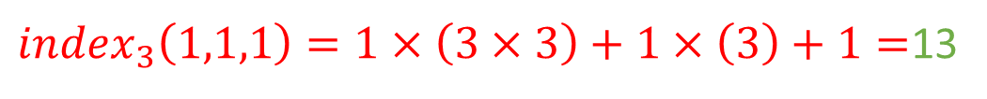
Data Organization – Index Computation $n$-D
A 3-D array of size $d_{1}×d_{2}×d_{3}$, the 1-D array offset of element $\left(i_{1},i_{2},i_{3}\right)$ stored using row-major order will be,
3D Array (3x3x3)
$$index_{3}\left(i_{1},i_{2},i_{3}\right)=i_{1}×\left(d_{2}×d_{3}\right)+i_{2}×d_{3}+i_{3}$$
$index_{3}\left(1,1,1\right)=1×\left(3×3\right)+1×\left(3\right)+1=$13
$$index_{3}\left(0,1,1\right)=0×\left(3×3\right)+1×\left(3\right)+1=4$$
$$index_{3}\left(2,2,1\right)=2×\left(3×3\right)+2×\left(3\right)+1=25$$

Slide 23
Implementing the MultiArray
#implementation of multiarray ADT using 1-D array import sys sys.path.append('../') from myarray import Array class MultiArray: def __init__(self, *dimensions): assert len(dimensions) > 1, "Dimensions can not be less than 1" self._dims = dimensions size = 1 for d in dimensions: assert d > 0, "Dimensions should be greater than 0" size *= d #create a 1-D array to store all elements self._elements = Array(size) #create 1-D array to store the equation factors self._factors = Array(len(dimensions)) self._computeFactors()

Slide 24
Implementing the MultiArray
#no of dimensions in the array def numDims(self): return len(self._dims) #returns the lenth of the given dimension def length(self, dim): assert dim >= 1 and dim <= len(self._dims),\ "Dimension component out of range" return self._dims[dim-1] #def clears the array by setting all elements to value def clear(self, value): self._elements.clear(value) #returns the cotnest of element(i_1, i_2,..., i_n) def __getitem__(self, ndxTuple): assert len(ndxTuple) == self.numDims(), "Invalid array subscripts!" index = self._computeIndex(ndxTuple) assert index is not None, "Array subscript out of range" return self._elements[index]

Slide 25
Implementing the MultiArray
#sets the contents of element(i_1, i_2, i_3,...i_n) def __setitem__(self, ndxTuple, value): assert len(ndxTuple) == self.numDims(), "Invalid # of array subscripts" index = self._computeIndex(ndxTuple) assert index is not None, "Array subscript out of range" self._elements[index] = value #computes a 1-D array offset for element (i_1, i_2, ...i_n) #using the equation i_1 * f_1 + i_2 * f_2 +.... + i_n * f_n def _computeIndex(self, idx): offset = 0 for j in range(len(idx)): #make sure the index componens within the legal range if idx[j] < 0 or idx[j] >= self._dims[j]: return None else: offset += idx[j] * self._factors[j] return offset #computes the factor values used in the index equation #done as part of exercise def _computeFactors(self): self._factors[len(self._factors)-1] = 1 for j in reversed(range(len(self._factors) - 1)): self._factors[j] = self._factors[j+1] * self._dims[j+1]

Slide 26
Assignment-2
Complete the Set ADT by implementing intersect() and difference().
Modify the Set() constructor to accept an optional variable argument to which a collection of initial values can be passed to initialize the set. The prototype for the new constructor should look as follows: def Set( self, *initElements = None ), It can then be used as shown here to create a set initialized with the given values: s = Set( 150, 75, 23, 86, 49 )
Add a new operation to the Set ADT to test for a proper subset. Given two sets, A and B, A is a proper subset of B, if A is a subset of B and A does not equal B.

Slide 27
Assignment-3
Add the str() method to the Set implementation to allow a user to print the contents of the set. The resulting string should look similar to that of a list, except you are to use curly braces to surround the elements.
Write a function that extracts the sales data from a text file and builds the 3-D array used to produce the various reports in Section 3.4. Assume the data file has the format as described in the chapter 3.
Due Date: Sunday 6th November 2022 @ 11:00PM

